Slide 1
Federal Policy Update
Elizabeth Hagan
Families USA
Notes:
.

Slide 2
Agenda
Reenrollment Processes
Application Changes and Plan Selection
Data Matching Issues
Areas to Improve
Call Center
Special Enrollment Periods

Slide 3
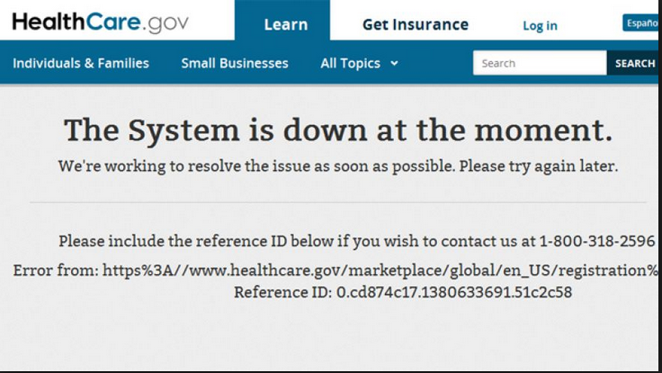
The FFM Three Years Ago…

Slide 4
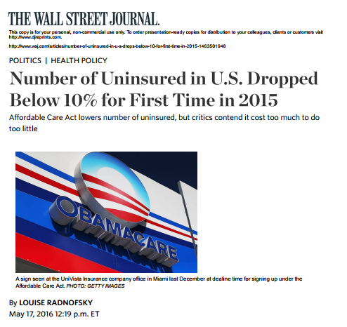
But Progress Has Been Made!

Slide 5
Pennsylvania’s Progress So Far
Sources: HHS Office of the Assistant Secretary of Planning and the Centers for Medicare and Medicaid Services

Slide 6
Breaking Down Pennsylvania
77% received financial assistance
51% received cost sharing reductions
Source: https://aspe.hhs.gov/sites/default/files/pdf/188026/MarketPlaceAddendumFinal2016.pdf

Slide 7
Drop in Uninsured in Pennsylvania
Source: Gallup’s uninsured estimates from February 24, 2015: http://www.gallup.com/poll/181664/arkansas-kentucky-improvement-uninsured-rates.aspx and February 4, 2016 (http://www.gallup.com/poll/189023/arkansas-kentucky-set-pace-reducing-uninsured-rate.aspx)

Slide 8
Change in Uninsured by Race/Ethnicity
Source: United States Census Bureau Current Population Reports

Slide 9
Enrollment through Healthcare.gov
Source: HHS ASPE Open Enrollment Period Reports

Slide 10
Reenrollment Processes

Slide 11
Reenrollment Hierarchy
Reenroll in existing plan if it is available
Enroll in QHP at same metal level within the same product
If in silver plan: Reenroll in silver plan with different product with same issuer if available or reenroll one level higher if not available
If not silver plan: Reenroll in one metal level higher or lower in same product
If current QHP not available and product no longer includes QHP at same or one higher or lower metal level, reenrolled in any other QHP offered under the product

Slide 13
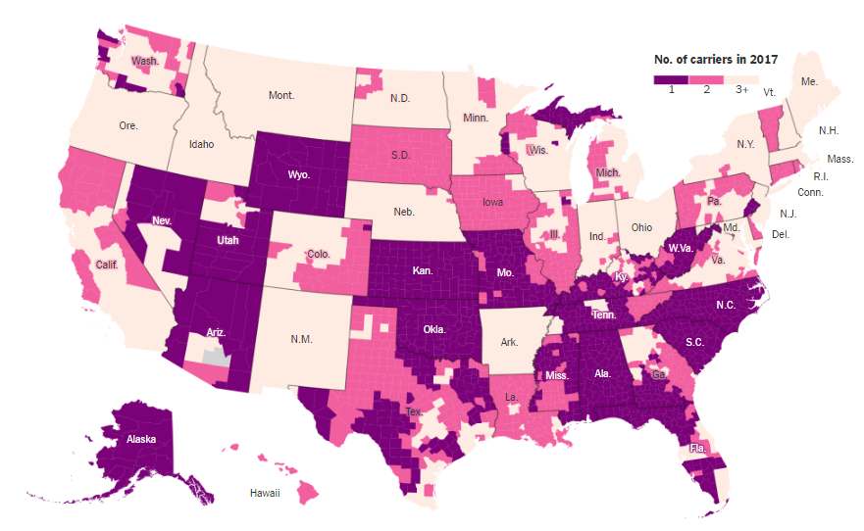
National Trends
Source: New York Times Analysis

Slide 14
A Closer Look at Pennsylvania
2017 Possible Carrier Participation in Exchange Rating Regions
 | Number of Rating Regions | Percentage of Rating Regions with 1 or Fewer Carriers | Percentage of Rating Regions with 2 Carriers | Percentage of Rating Regions with More than 2 Carriers
Pennsylvania | 9 | 11% | 56% | 33%
United States |  | 36% | 19% | 45%
Source: Avalere Health Analysis

Slide 15
A Closer Look at Pennsylvania
Distribution of Enrollees by Number of Potential Distribution in 2017
 | 1 Issuer | 2 Issuers | 3+ Issuers
Pennsylvania | 39% | 33% | 28%
United States | 19% | 19% | 62%
Source: Kaiser Family Foundation, August 26, 2016

Slide 16
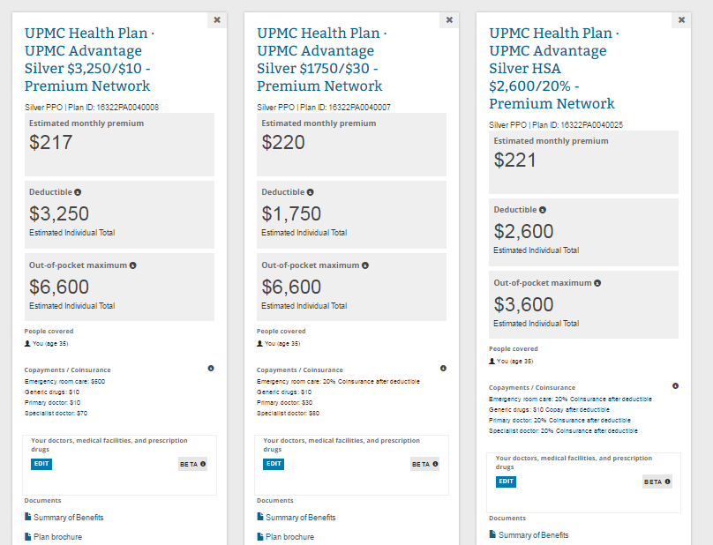
Remember!
Number of Issuers ≠ Number of Plans

Slide 17
Messaging health plan exit
Visit the Marketplace
Update information
Pay first month’s premium
Explore options

Slide 18
Who’s affected?

Slide 19
When an issuer exits Healthcare.gov
Notice sent by issuer
Automatically enrolled in alternative plan
Must pay first month’s premium

Slide 20
Alternative plan

Slide 21
When an issuer exits Healthcare.gov
Notice sent by issuer
Consumer must select new plan
Must pay first month’s premium

Slide 22
Who’s at greatest risk?

Slide 23
Application Changes and Plan Selection

Slide 24
Application Changes

Slide 25
Plan Selection Updates
Enrollment Progression
Standardized plans
Choosing Costs
Post-enrollment confirmation
Integrated tools

Slide 26
Enrollment Progression
Step 1
Step 2
Step 3
Enroll To-Do List

Slide 27
Enrollment Progression
Step 1
Step 2
Step 3

Slide 28
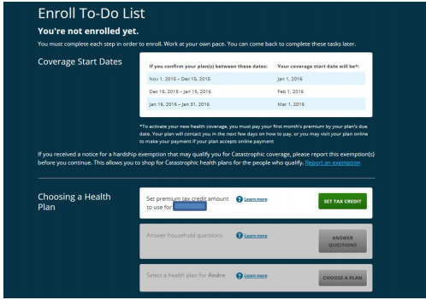
X
Enroll To-Do List

Slide 29
Integrated Tools
Window Shopping Tool
Plan selection

Slide 30
Features Added Into Plan Selection Tool
Doctor Lookup
Formulary
Estimated Costs

Slide 31
Remaining Features
Filters
Sorting
Ability to Compare Plans
Quick and Longer View of Plan Details

Slide 32
Plan Selection Updates
Choosing Costs
Standardized Plans
Post-Enrollment Reminders

Slide 33
Data Matching Issues

Slide 34
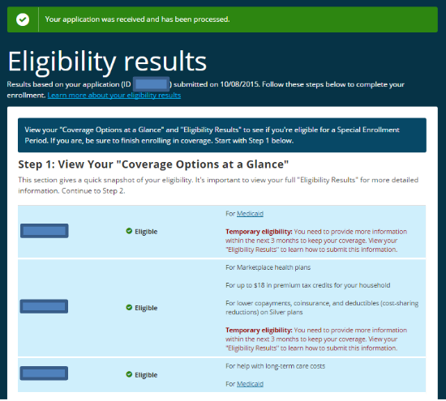
Data Matching Issues (DMIs)

Slide 35
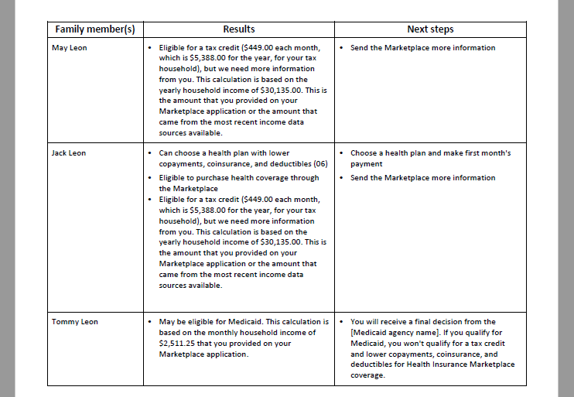
Data Matching Issues (DMIs)

Slide 36
Data Matching Issues (DMIs)
Tips/prompts
New thresholds
History
Call center help

Slide 37
Call Center

Slide 38
Call Center
Consumer or assister has ability to press option for password and username reset
Consumer or assister calls call center
Consumer or assister can proceed as normal

Slide 39
Call Center
Consumer call center
Separate option for account reset
Assister line
Password reset
Non-application SEPs with trained representatives
Regular application questions

Slide 40
Special Enrollment Periods

Slide 41
SEP Confirmation Process
Loss of minimum essential coverage
Permanent move
Marriage
Birth
Adoption, placement for adoption, foster care, or other court order

Slide 42
Process Since June 17, 2016
Apply for Coverage
Receive Notice
Provide Documentation
Enroll in Plan

Slide 43
Pre-Enrollment Verification Pilot
Apply for Coverage
Prove Eligibility
Enroll in Plan

Slide 44
Outstanding Questions on SEP Pilot
When will the pilot be implemented?
Where will it be implemented?
What SEPs will require pre-enrollment verification?
How will this affect enrollment?
What will the SEP enrollment process be?

Slide 45
Changes to the Permanent Move SEP
Move SEP until July 11, 2016
Those who move to new QHP service area may be eligible to enroll in QHP coverage
Move SEP since July 11, 2016
Only those who had coverage for one or more days in the 60 days before a move may enroll in QHP coverage
Exceptions
Individuals who move to the United States from outside the U.S. or from a U.S. territory
Individuals who gain access to coverage because they are released from incarceration
Individuals who were previously in the coverage gap in a non-Medicaid expansion state and have moved and become newly eligible for advance payments of the premium tax credit

Slide 46
Changes to the Permanent Move SEP
Original Policy
Marketplaces were required to provide consumers with the option to apply for coverage 60 days prior to their move beginning January 1, 2017
New Policy
Marketplaces have the option to allow consumers to apply for coverage 60 days prior to their move

Slide 47
Changes to the Permanent Move SEP
2016
2017
Unknown
Notify marketplace of upcoming move
Release from incarceration
Move
Special enrollment period triggered
Special enrollment period triggered
60 days to enroll in coverage
60 days to enroll in coverage

Slide 48
Areas to Improve

Slide 49
Opportunities for Improvement
Special Enrollment Periods
CHIP extension
Affordability
Family Glitch

Slide 50
When at an impasse…

Slide 51
Story Bank Toolkit
http://familiesusa.org/initiatives/story-bank-toolkit

Slide 52
Resources

Slide 53
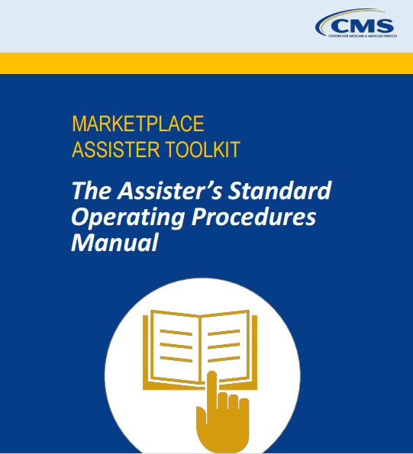
Standard Operating Procedures
https://marketplace.cms.gov/technical-assistance-resources/assister-sop-manual.pdf

Slide 54
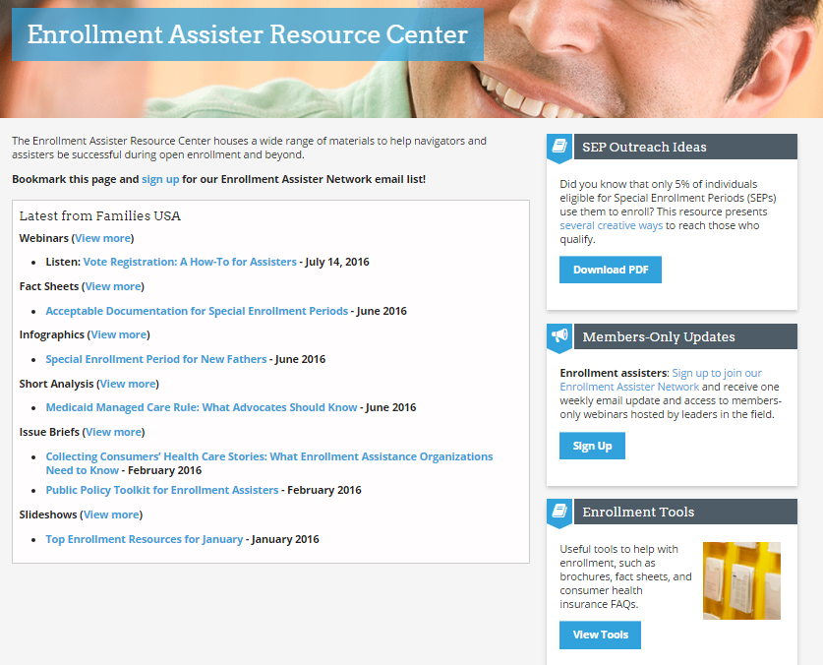
Families USA Resources
http://familiesusa.org/initiatives/enrollment-assister-resource-center

Slide 55
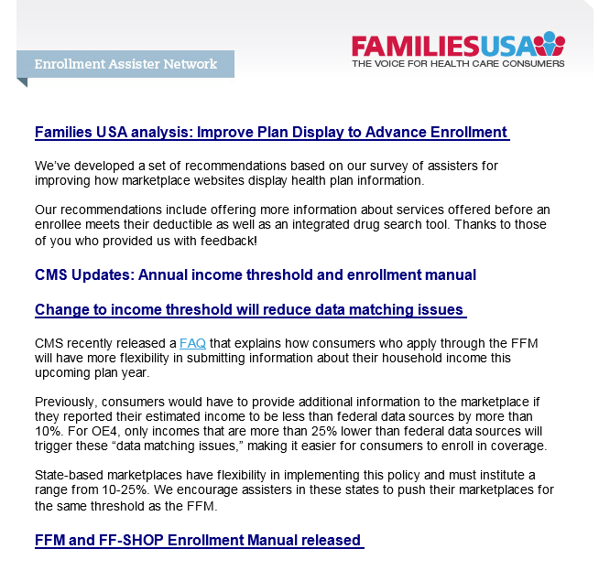
Families USA Weekly Newsletter
http://familiesusa.org/enrollment-assister-resource-center-sign

Slide 56
Thank You!

Slide 57
Please keep in touch with us!
Elizabeth Hagan
ehagan@familiesusa.org
@Hagan_Elizabeth
@FamiliesUSA
1201 New York Avenue, NW, Suite 1100
Washington, DC 20005
main 202-628-3030 / fax 202-347-2417

